Slide 1
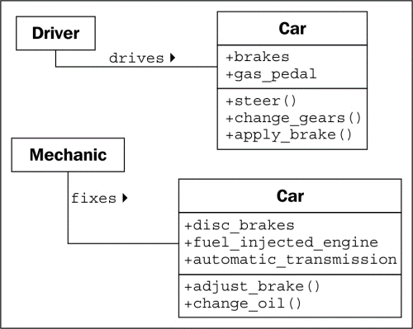

Object Oriented Programming

Slide 2
Chapter 4
Using decision statements
Declaring Boolean Variables
A Boolean expression always evaluates to true or false
Primitive data type
Holds one of two values
Boolean Operator
Performs a calculation whose result is either true or false
NOT operator (!): negates Boolean value , yields opposite
Example: !areYouReady , value was true until ! Now false
Equality operator (==)
Inequality operator (!=)
both equality and inequality operators are binary operators with which you can determine whether
One value is the same as the other value of the same type, yielding a Boolean result.
example: x==y, x!=y
Relational Operators: determines if a value is less than or greater than a value of the same type
< less than
<= less than or equal to
> greater than
>= greater than or equal to
** result of relational operators are also Boolean results.
Conditional logical Operators: Binary Boolean Operators
AND (&&) operator and the OR (II) operator

Slide 3
Conditional logical Operators: Binary Boolean Operators
AND (&&) operator and the OR (II) operator
Combine two Boolean expressions or values into a single Boolean result.
Example: bool validPercentage;
validPercentage = (percent >= 0) && (percent <= 100);
Outcome of AND (&&) operator is only true if BOTH Boolean expressions are true.
Example: bool invalidPercentage;
invalidPercentage = (percent >= 0) II (percent <= 100);
Outcome of OR (II) operator is only true if ONE OF the Boolean expressions are true.
SHORT CIRCUITING: USING THE AND (&&) and the OR(II) operators
Evaluates only one side of the Boolean expression.
If left operand of && expression is False, there is no need to evaluate the other side.
If the left operand of the II expression is true, there is no need to evaluate the other side.
Purpose is to boost the performance of you code by avoiding unnecessary work.

Slide 4
Operator Precedence and Associativity
Page 90-91
Category | Operators | Associativity
Primary | (),++,- - | Left
Unary | !,+,-,++,- - | Left
Multiplicative | *,/,% | left
Additive | +,- | Left
Relational | <,<=,>,>= | Left
Equality | ==,!= | Left
Conditional AND | && | Left
Conditional OR | II | Left
Assignment | = | right

Slide 5
If statement
Use an If statement: Executing two different statements depending on the result
of a Boolean expression
Syntax:
if(Boolean expression)
statement-1:
else
statement-2;
If Boolean expression evaluates to true, execute “statement-1”
Otherwise “statement-2 is executed.
**else clause and statement are optional, if excluded, the code will continue
with whatever statement
Follows.
Boolean expression must be enclosed in (),
The expression must be a Boolean expression only, do not mistake the (==) equality
Operator for the assignment operator (=) or you will have a compiler error.

Slide 6
Using blocks to group statements
(more than one if statement)
Block: a sequence of statements grouped between an
opening brace and a closing brace
If you do not use curly braces to separate your if statements, the compiler only
Associates the first statement with the if statement and omits the rest, and will not
Compile the else statement but report a syntax error.
Always define the statements for each branch of your if statement within a block,
Even if your only using one block. Reminder, a block always starts a new “SCOPE”
Example
Int seconds = 0;
Int minutes = 0;
If (seconds == 59)
{
seconds = 0;
minutes++;
}
Else
{
seconds++;
}

Slide 7
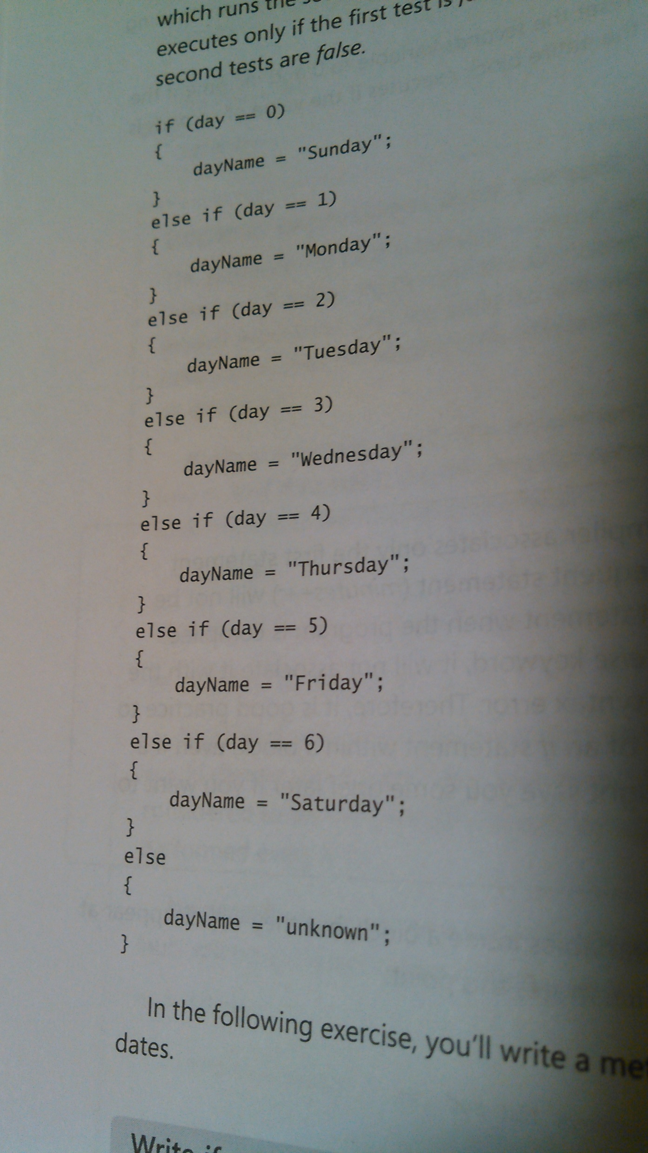
Cascading if statement
Nesting if statements inside of if statements
Chain together a series of Boolean expressions
Testing one expression after an other until one evaluates to true
Example:

Slide 8
Switch Statement
Option of replacing cascading if statements with switch statements to make
Code for efficient and more readable
Switch Statement Syntax
switch (controllingExpression)
{
case constantExpression :// each one must be unique,only one matches
statements
break;
case constantExpression :
statements
break:
default:
statements
break;
ControllingExpression is evaluated once.
Control then jumps to the block of code identified by the constantExpression
Whose value is equal to the result of the controllingExpression.
ConstantExpression: “case label”
Execution runs as far as the “break” statement
Default statement is executed if none of the constantExpressions match the
controllingExpression.
No default statement and no expressions match? The code immediately following the
Closing braces of switch statement are executed

Slide 9
Switch Statement Rules
You can only use switch on certain data types, such as int, char, or string. With any other
Value types you must use an if statement.
The case labels must be constant expressions, i.e. 42 if int, ‘4’ if char, “42” if string. If you
Need to calculate your case labels at runtime, you must use an if statement.
The case labels must be unique, two case labels cannot have the same value.
“Fall-through”: you can specify that you want to run the same statement for more than one
value by providing a list of case labels and no intervening statements. However, this is not
Allowed if label has one or more associated statements this is not allowed.
Example
Switch(trumps)
{
case Hearts:
case Diamonds:
color = “red”;
break;
case Clubs:
color = “black”;
case Spades:
color = “black”:
break:
}
Fall-Through
Break or return statement prevents fall-through
Or throw an exception
Fall-through will not take place if there is any
Intervening code, so case labels can be arranged however
You want

